Slide 1


Slide 2


Slide 3


Slide 4


Slide 5


Slide 6
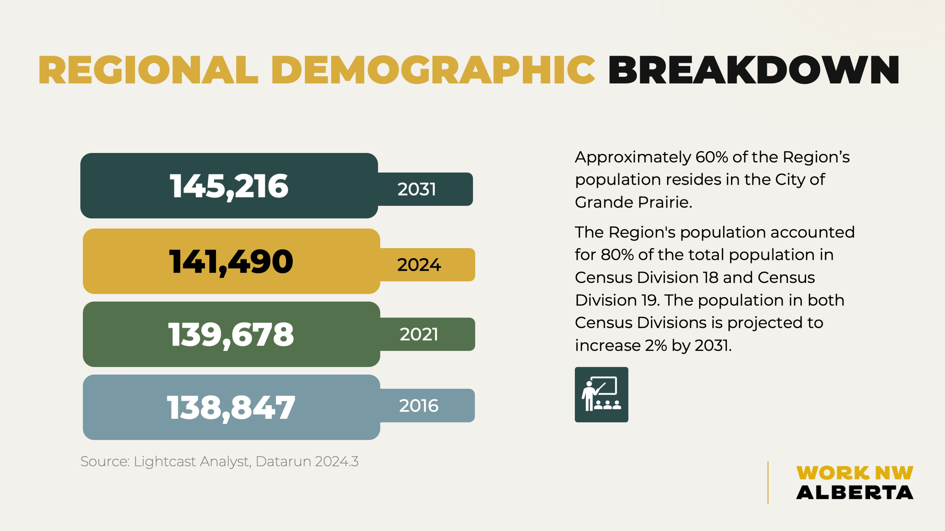

Slide 7


Slide 8


Slide 9


Slide 10


Slide 11


Slide 12


Slide 13
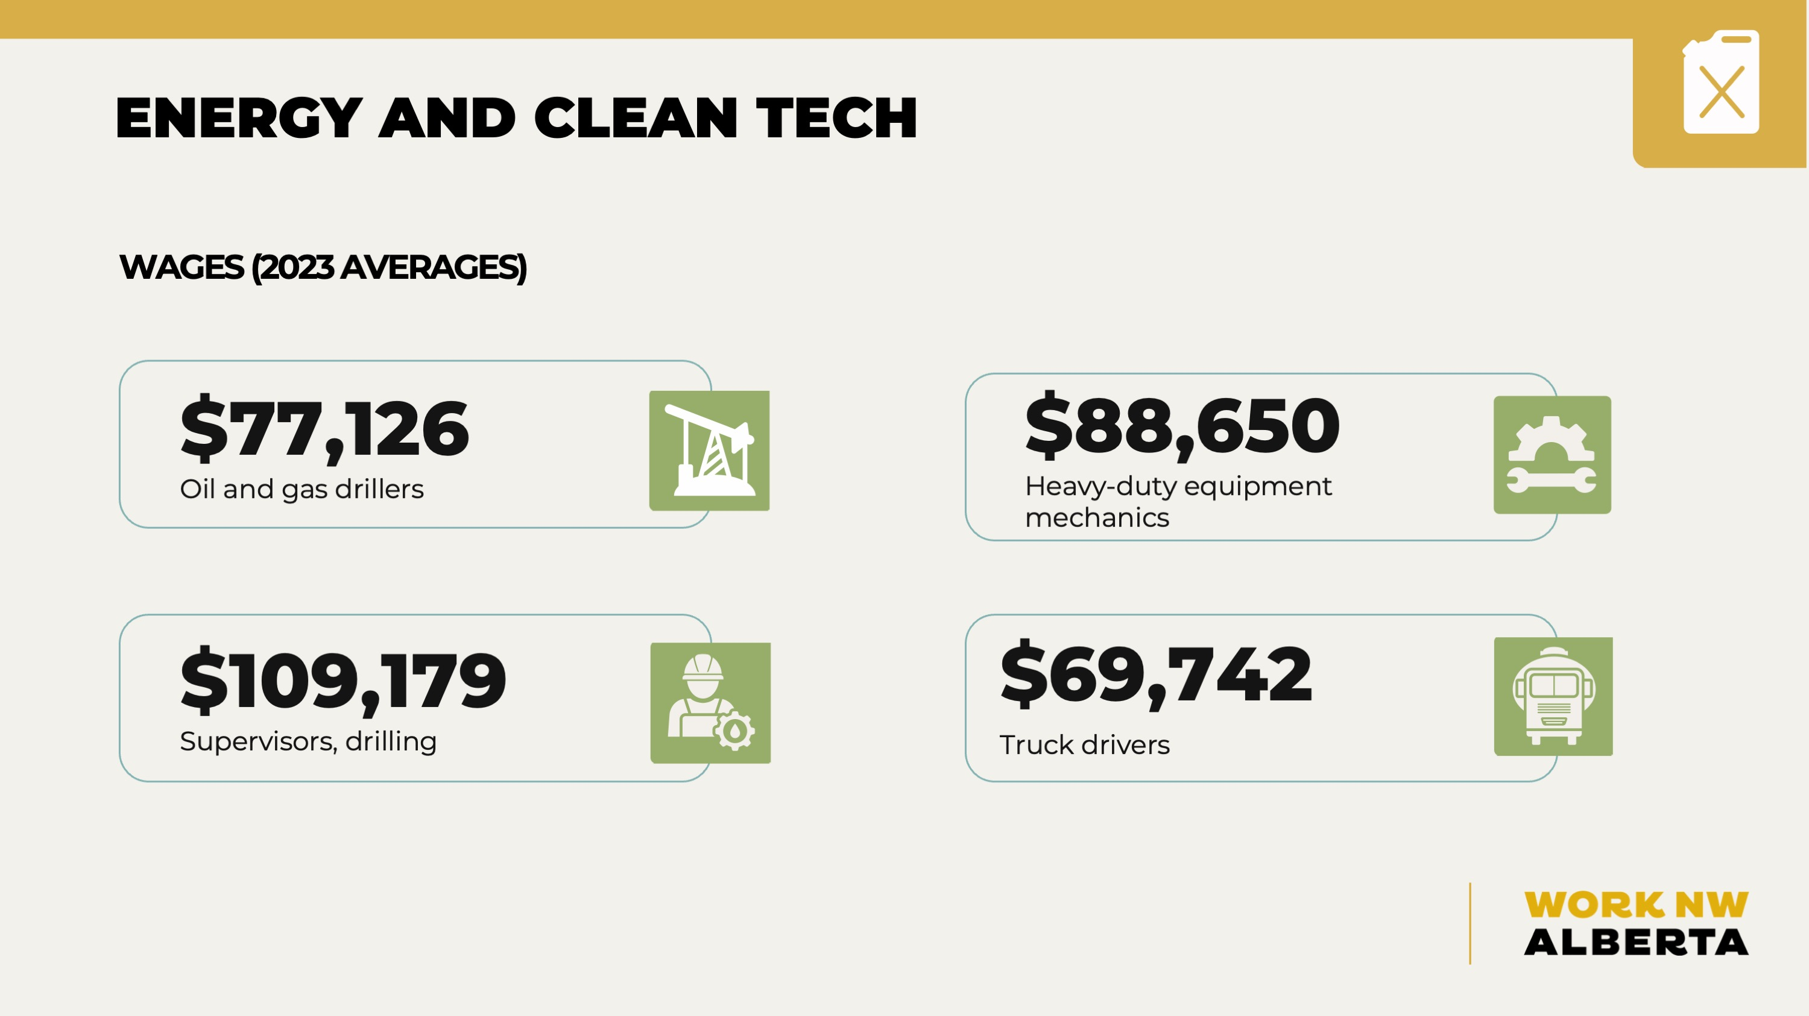

Slide 14


Slide 15


Slide 16
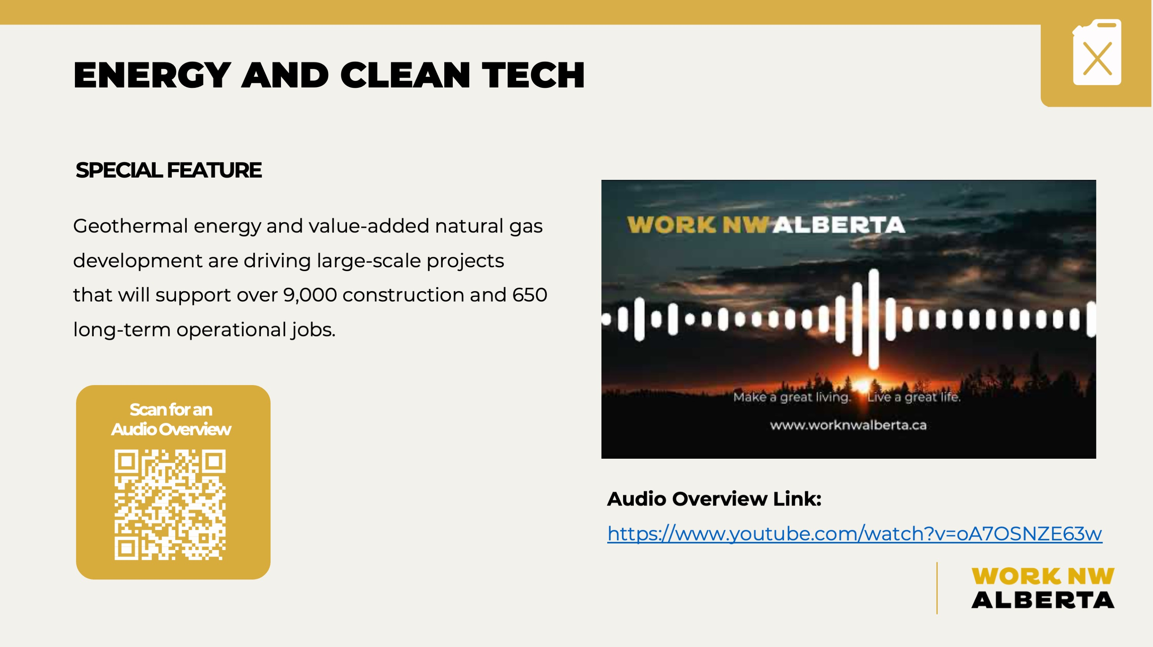

https://www.youtube.com/watch?v=oA7OSNZE63w

Slide 17


Slide 18


Slide 19


Slide 20
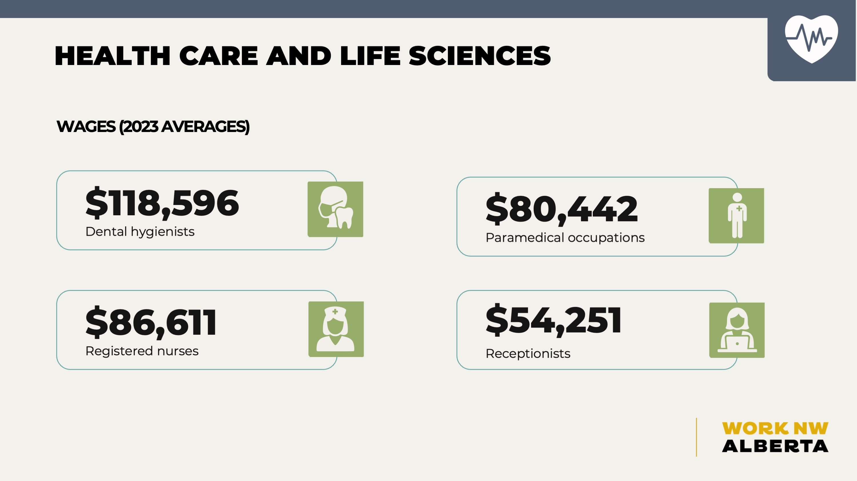

Slide 21
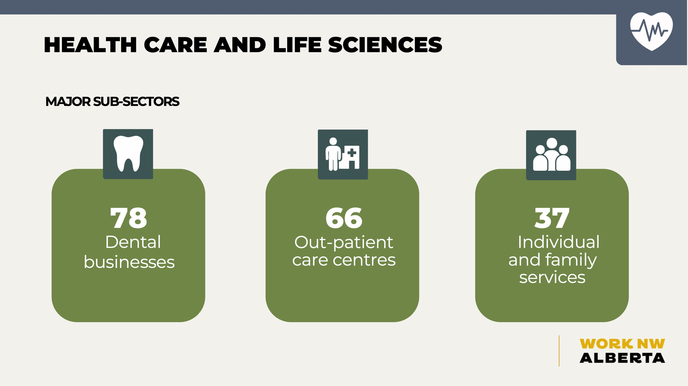

Slide 22


Slide 23
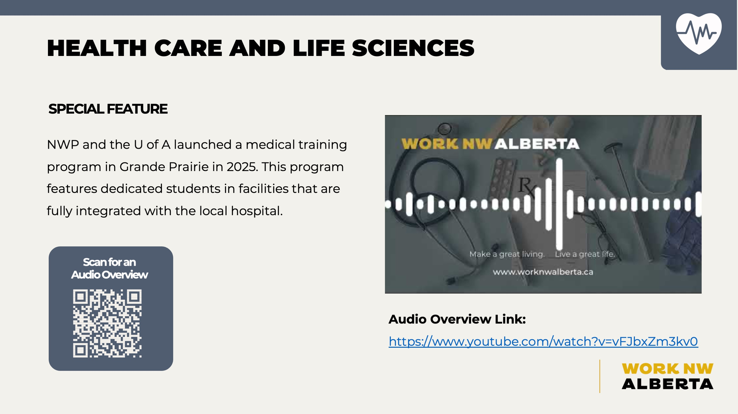

https://www.youtube.com/watch?v=vFJbxZm3kv0

Slide 24


Slide 25


Slide 26


Slide 27
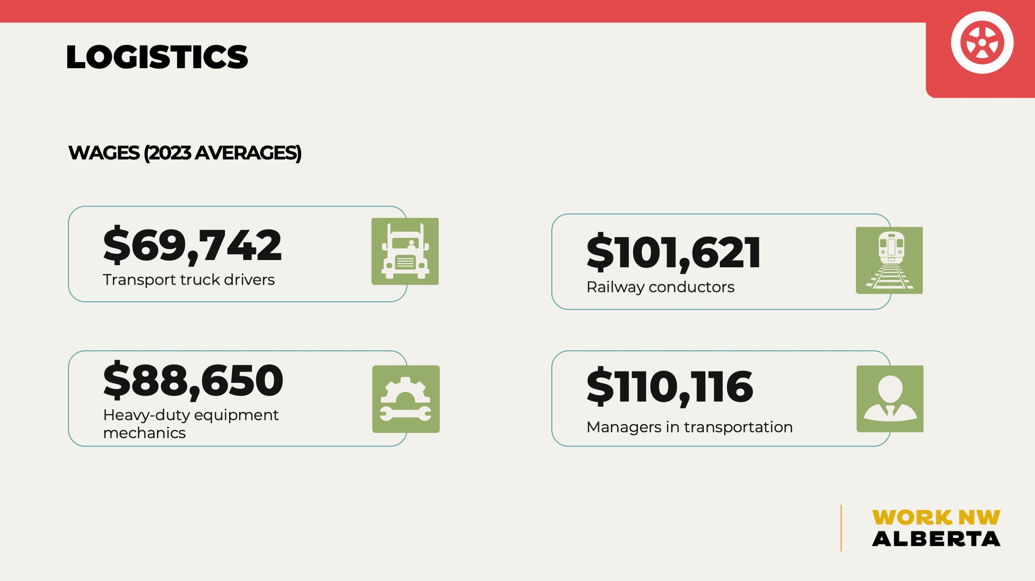

Slide 28


Slide 29


Slide 30
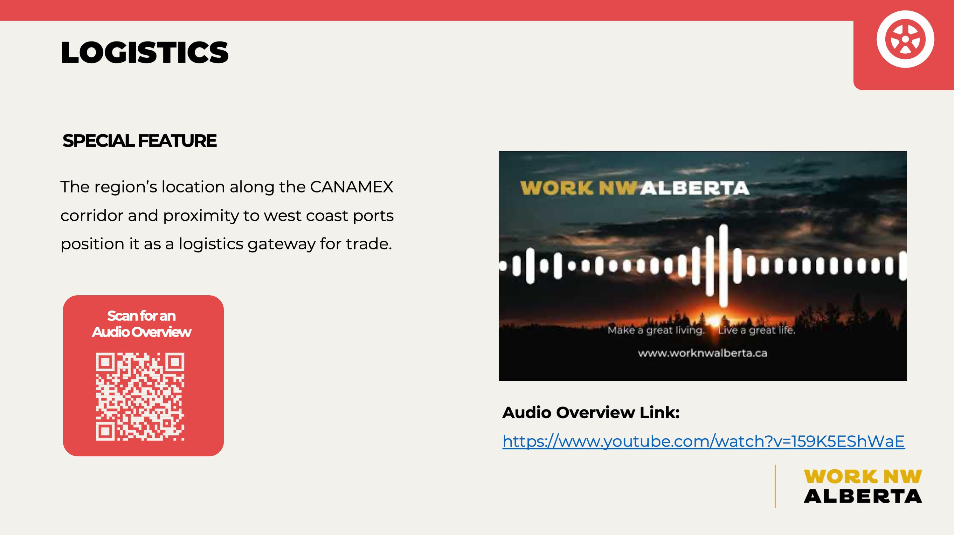

https://www.youtube.com/watch?v=159K5EShWaE

Slide 31


Slide 32


Slide 33


Slide 34


Slide 35


Slide 36


Slide 37


https://www.youtube.com/watch?v=tr1Yc4-iYKs

Slide 38


Slide 39


Slide 40


Slide 41


Slide 42


Slide 43


Slide 44


https://www.youtube.com/watch?v=BKTFvinQxVc

Slide 45


Slide 46


Slide 47


Slide 48
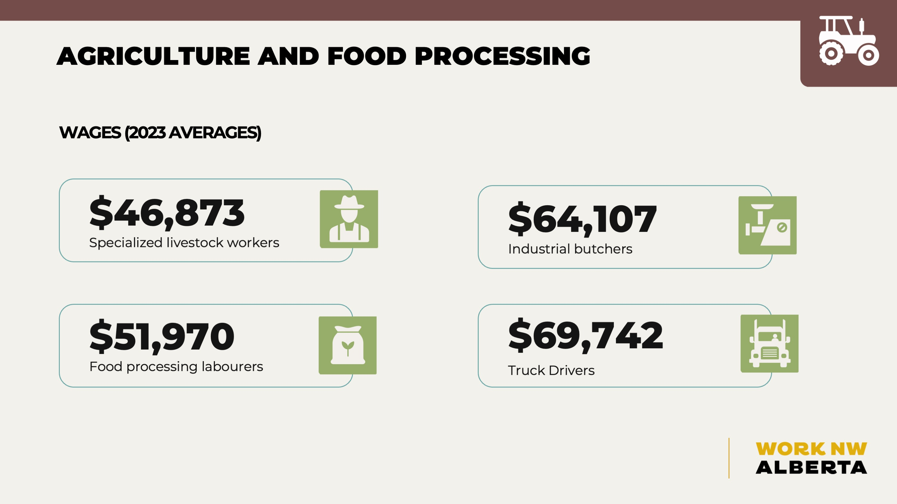

Slide 49
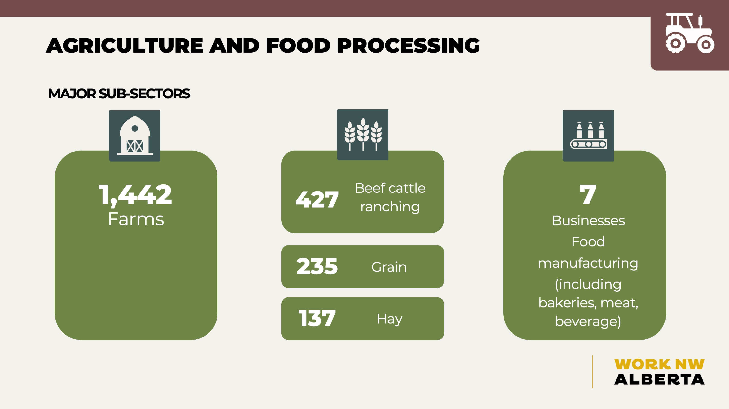

Slide 50


Slide 51
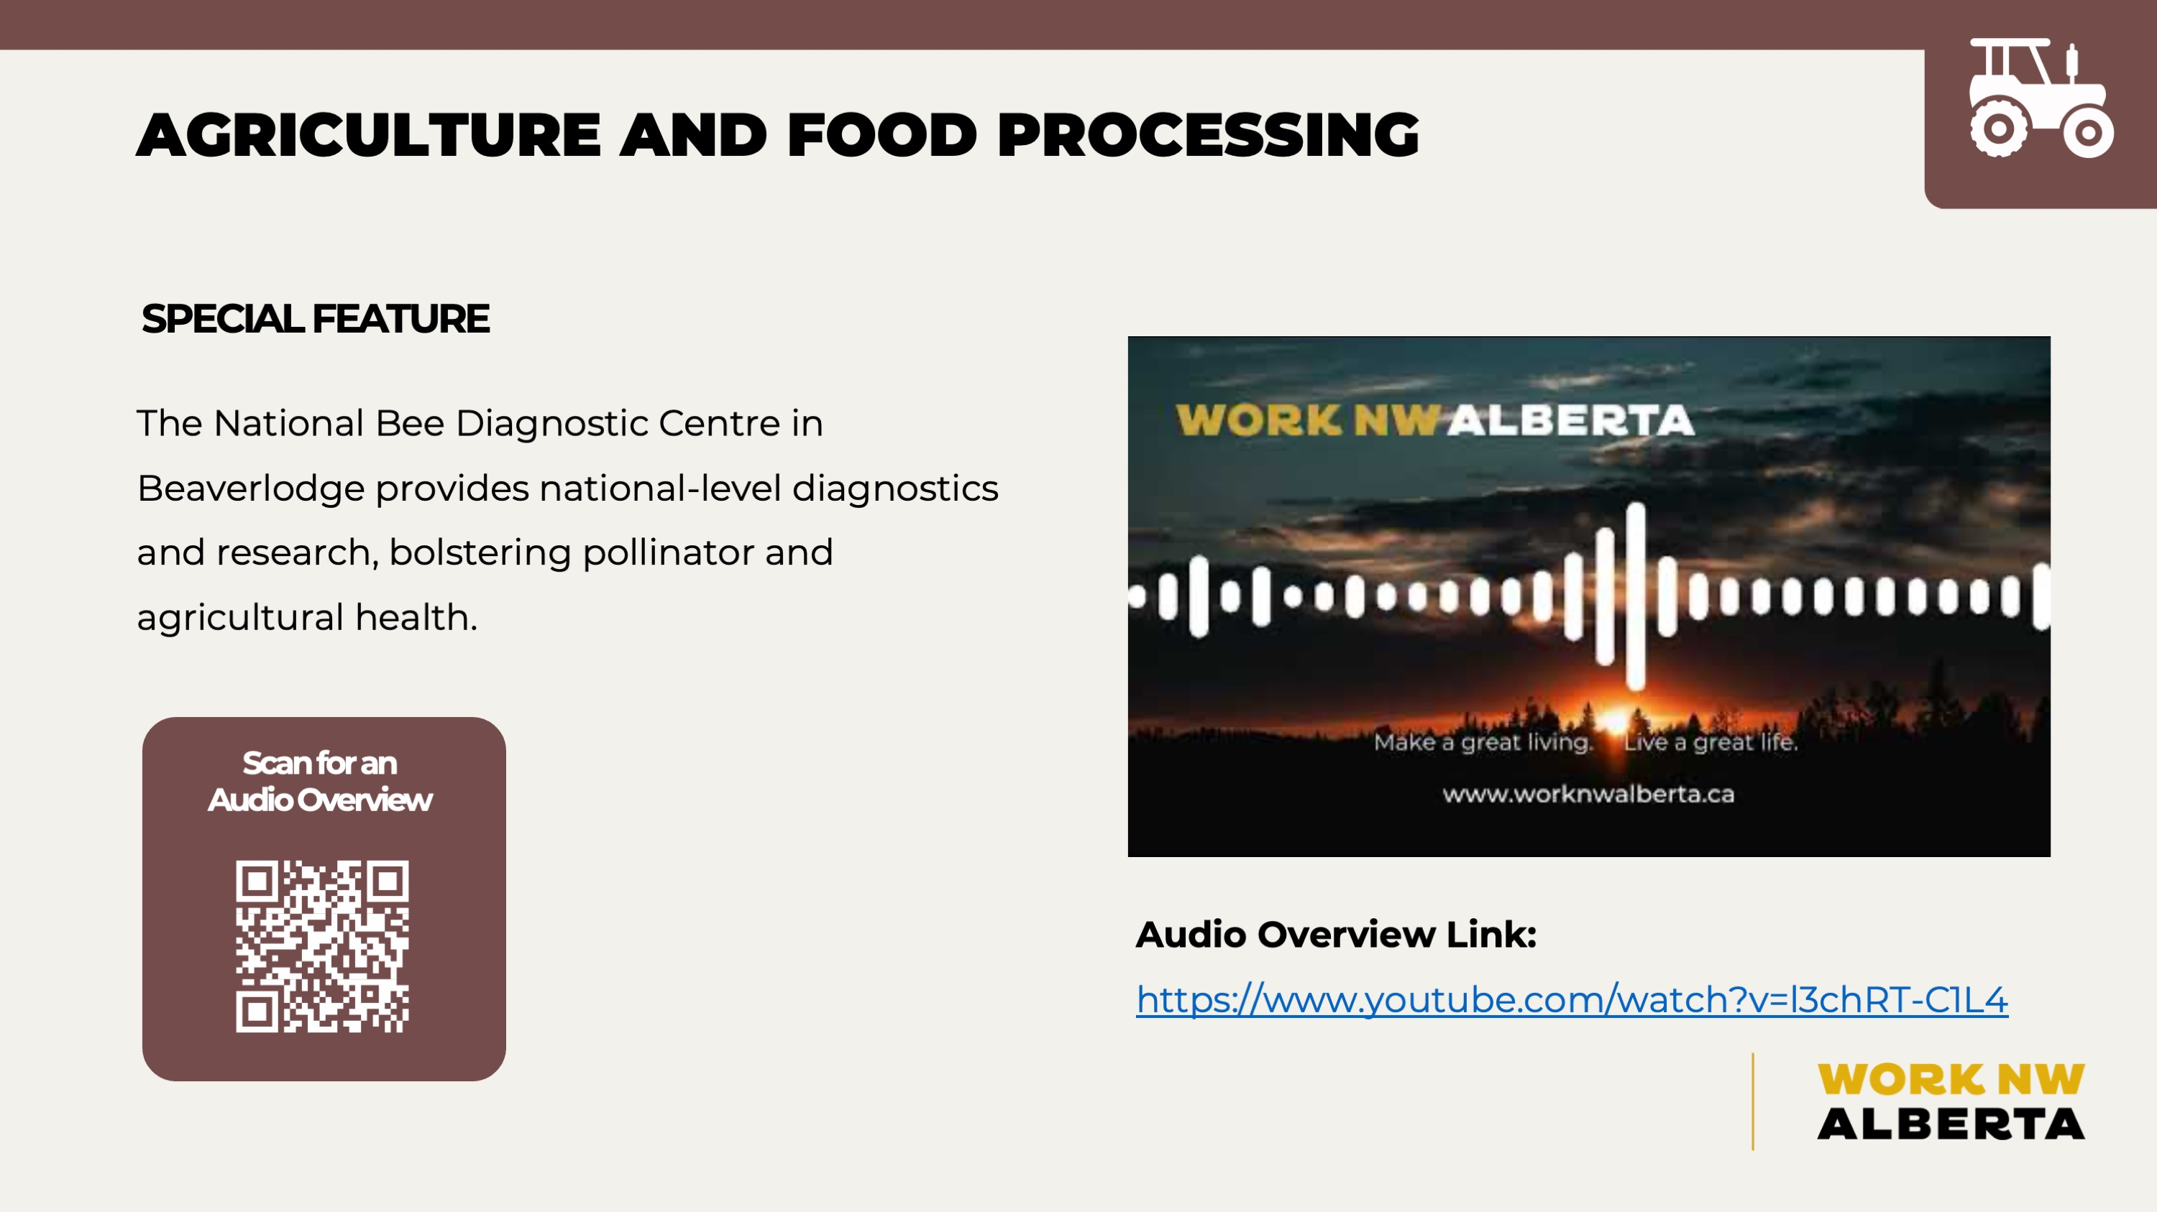

https://www.youtube.com/watch?v=l3chRT-C1L4

Slide 52


Slide 53


Slide 54


Slide 55


Slide 56


Slide 57


Slide 58
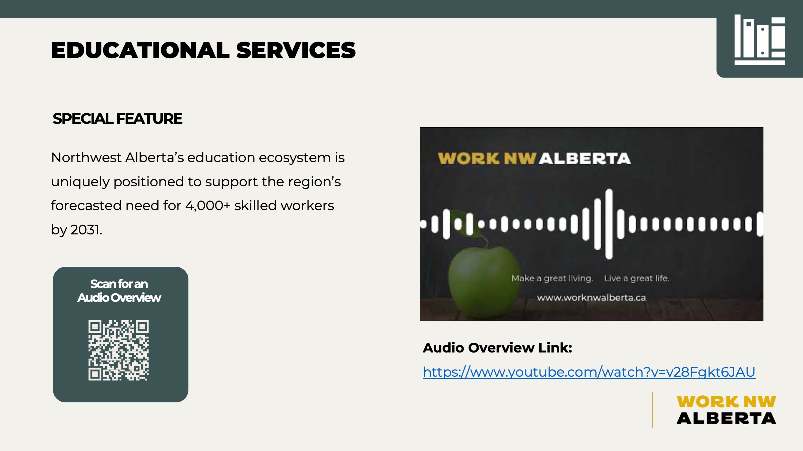

https://www.youtube.com/watch?v=v28Fgkt6JAU

Slide 59


Slide 60


Slide 61


Slide 62


Slide 63


Slide 64


Slide 65


Slide 66


Slide 67


Slide 68


Slide 69


